Slide 1
COMMUNIATION SKILLS
BY
N C BASTRAY

Slide 2

What is Communication?
Communication is the process of transferring signals/ messages/ information/ ideas and attitudes from one person to another i.e. between a sender and a receiver through various
methods (written words, nonverbal cues, spoken words etc.). It is also the process of meaningful interaction among human beings.

Slide 3
Basic Communication Skills Profile
________________________________________________
Communication Order Learned Extent Used Extent Taught
____________________________________________
Listening First First Fourth
Speaking Second Second Third
Reading Third Third Second
Writing Fourth Fourth First

Slide 4
What are the most common ways we communicate?
Visual Images
Spoken Word
Written Word
Body Language

Slide 5
Communication is a Series of Experiences of
Hearing
Smell
Seeing
Touch
Taste

Slide 6
TOTAL COMMUNICATION PROCESS

Slide 7
IMPACT OF COMMUNICATION
7% WORDS
Words are only labels and the listeners put their own interpretation on speakers words
38% PARALINGUISTIC
The way in which something is said - the accent, tone and voice modulation is important to the listener.
55% BODY LANGUAGE
What a speaker looks like and what is his body language while delivering a message affects the listener’s understanding most.

Slide 8
How to Develop Good Communication Skills
Understanding the Basics of Communication Skills
Engaging Your Audience
Using Your Words
Using Your Voice
The ability to communicate effectively is important in relationships, education and work. Here are some steps and tips to help you develop good communication skills.

Slide 9

Understanding the Basics of Communication Skills
1.Have courage to say what you think.
Be confident in knowing that you can make worthwhile contributions to conversation. Take time each day to be aware of your opinions and feelings so you can adequately convey them to others.
Individuals who are hesitant to speak because they do not
feel their input would be worthwhile, so they need not fear.
What is important or worthwhile to one person may
not be to another and may be more so to someone else

Slide 10
2. Practice
Developing advanced communication skills begins with simple interactions. Communication skills can be practised every day in settings that range from the social to the professional. New skills take time to refine, but each time we should use our communication skills and keep open ourselves to opportunities and future partnerships.

Slide 11

2. Engaging Your Audience
1. Make eye contact: Whether you are speaking or listening, looking into the eyes of the person with whom you are conversing can make the interaction more successful. Eye contact conveys interest and encourages your partner to be interested in you in return. One technique to help with this is to consciously look into one of the listener’s eyes and then move to the other eye.
Going back and forth between the two makes your eyes appear to sparkle. Another trick is to imagine a letter “T” on the listener’s face ,with the cross bar being an imaginary line across the eye brows and the vertical line coming down the center of the nose. Keep your eyes scanning that “T” zone.

Slide 12
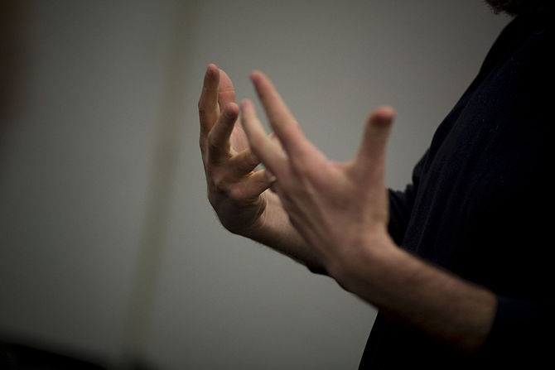
2 Use gestures.
These include gestures with your hands and face. Make your whole body talk. Use smaller gestures for individuals and small groups. The gestures should get larger as the group that one is addressing increases in size.

Slide 13

3 Don’t send mixed messages. Make your words, gestures, facial expressions and tone match. Disciplining someone while smiling sends a mixed message and is therefore ineffective. If you have to deliver a negative message, make your words, facial expressions, and tone match the message.

Slide 14
4 Be aware of what your body is saying. Body language can say so much more than a mouthful of words. An open stance with arms relaxed at your sides tells anyone around you that you are approachable and open to hearing what they have to say.
1. Arms crossed and shoulders hunched, on the other hand, suggest disinterest in conversation or unwillingness to communicate. Often, communication can be stopped before it starts by body language that tells people you don't want to talk.
2. Appropriate posture and an approachable stance can make even difficult conversations flow more smoothly.

Slide 15
5 Manifest constructive attitudes and beliefs. The attitudes you bring to communication will have a huge impact on the way you compose yourself and interact with others. Choose to be honest, patient, optimistic, sincere, respectful, and accepting of others. Be sensitive to other people’s feelings, and believe in others' competence.

Slide 16
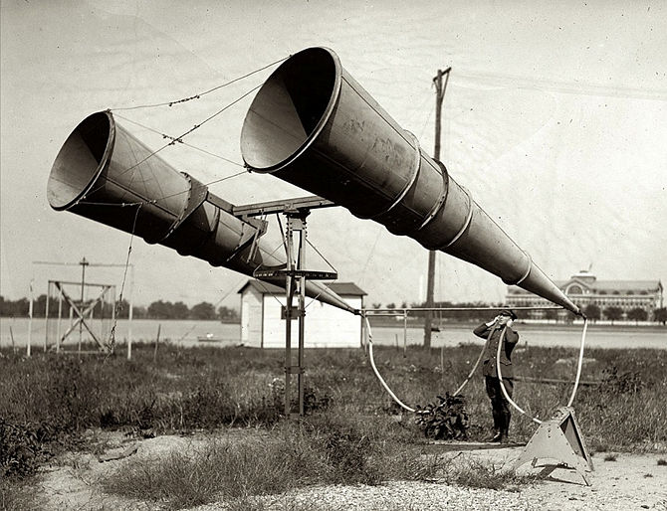
6 Develop effective listening skills: Not only should one be able to speak effectively, one must listen to the other person's words and engage in communication on what the other person is speaking about.
Avoid the impulse to listen only for the end of their sentence so that you can blurt out the ideas or memories while the other person is speaking.

Slide 17
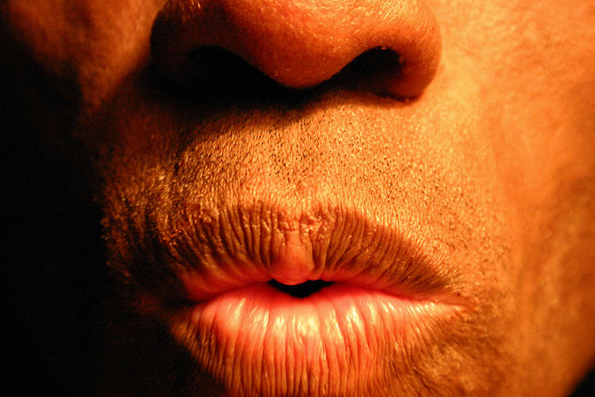
3. Using Your Words
1 Enunciate your words. Speak clearly and don’t mumble. If people are always asking you to repeat yourself, try to do a better job of articulating yourself in a better manner.
2 Pronounce your words correctly. People will judge your competency through your vocabulary. If you aren’t sure of how to say a word, don’t use it.

Slide 18
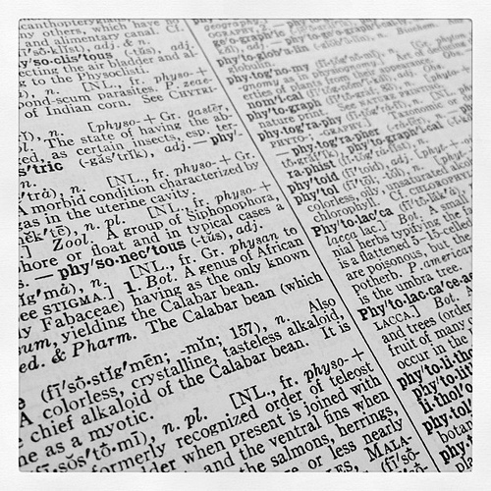
3 Use the right words. If you’re not sure of the meaning of a word, don’t use it. Grab a dictionary and start a daily habit of learning one new word per day. Use it sometime in your conversations during the day.
4 Slow your speech down. People will perceive you as nervous and unsure of yourself if you talk fast. However, be careful not to slow down to the point where people begin to finish your sentences just to help you finish.

Slide 19
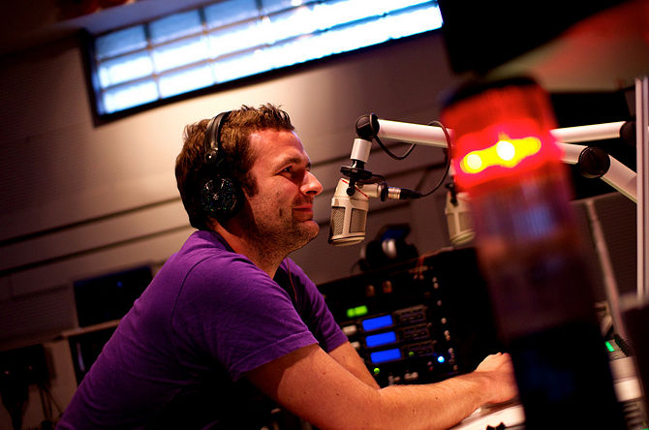
4. Using Your Voice
1. Develop your voice. A high or whiny voice is not perceived to be one of authority. In fact, a high and soft voice can make you sound like prey to an aggressive co-worker or make others not to take you seriously. Begin doing exercises to lower the pitch of your voice and make it acceptable to your audience.

Slide 20
2 Animate your voice. Avoid a monotone and use dynamics. Your pitch should raise and lower periodically. It should be sweet and pleasant to your audience as per the need.
3 Use appropriate volume. Use a volume that is appropriate for the setting. Speak more softly when you are alone and close. Speak louder when you are speaking to larger groups or across larger spaces.

Slide 21



Barriers to communication
Noise
Inappropriate medium
Assumptions/Misconceptions
Emotions
Language differences
Poor listening skills
Distractions

Slide 22
VALUE OF LISTENING
Listening to others is an elegant art.
Good listening reflects courtesy and good manners.
Listening carefully to the instructions of superiors improve competence and performance.
The result of poor listening skill could be disastrous in business, employment and social relations.
Good listening can eliminate a number of imaginary grievances of employees.
Good listening skill can improve social relations and conversation.
Listening is a positive activity rather than a passive or negative one.

Slide 23
ESSENTIALS OF COMMUNICATION Dos
Always think ahead about what you are going to say.
Use simple words and phrases that are understood by every body.
Increase your knowledge on all subjects you are required to speak.
Speak clearly and audibly.
Check twice with the listener whether you have been understood accurately or not
In case of an interruption, always do a little recap of what has been already said.
Always pay undivided attention to the speaker while listening.
While listening, always make notes of important points.
Always ask for clarification if you are failed to grasp other’s point of view.
Repeat what the speaker has said to check whether you have understood accurately.

Slide 24
ESSENTIALS OF COMMUNICATION DON’Ts
Do not instantly react and mutter something in anger.
Do not use technical terms & terminologies not understood by majority of people.
Do not speak too fast or too slow.
Do not speak in inaudible surroundings, as you won’t be heard.
Do not assume that every body understands you.
While listening do not glance here and there as it might distract the speaker.
Do not interrupt the speaker.
Do not jump to the conclusion that you have understood every thing.

Slide 25
THANK YOU
Tips
Try to speak fluently and try to make sure people can hear you when you speak.
Do not interrupt or talk over the other person it breaks the flow of conversation.
Use appropriate volume for your conversation setting.
A good speaker is a good listener.
Get feedback from your receiver to ensure you were properly understood during your conversation.
Make sure you're using proper grammar.
Have confidence when talking, it doesn't matter what other people think.
Don't over-praise yourself in front of your audience.

